Slide 1
Visualizing your data effectively
Damian A. Tamburri, Ph.D.

Slide 2
What is data visualization?
“The representation and presentation of data that exploits our visual perception abilities in order to amplify cognition” –Andy Kirk
A part of the larger business intelligence (BI) umbrella
BI “helps organizations analyze historical and current data, so they can quickly uncover actionable insights for making strategic decisions”
Includes data preparation, data mining, data management, and data visualization
Notes:
books.google.com/books?hl=en&lr=&id=I4qBVLfD3t4C&oi=fnd&pg=PT6&ots=b7XMtLiI7q&sig=dAUXaw8qLiBX3To80ks1EypMssI
https://powerbi.microsoft.com/en-us/what-is-business-intelligence/
https://www.ibm.com/analytics/business-intelligence

Slide 3
Importance of data visualization
Effective method of communication
Offers different insights like patterns and comparisons
Visualizations help make data (especially big data)
Digestible
Accessible
And efficient
Notes:
https://www.eweek.com/big-data-and-analytics/data-visualization/

Slide 4
What makes a visualization effective?
Accurately and ethically represents source data
Made with the user in mind
Works with human perception
Accessible for all potential viewers
Leaves the viewer with actionable takeaways

Slide 5
Ethical data visualization
Data people are trusted keyholders
Ethics are a combination of journalism (reporting) and engineering (technical)
Use appropriate data gathering/selection and analysis
Choose most appropriate visualization rather than what looks good
Being clear
Being persuasive but not misleading
Notes:
https://mschermann.github.io/data_viz_reader/ethics.html

Slide 6
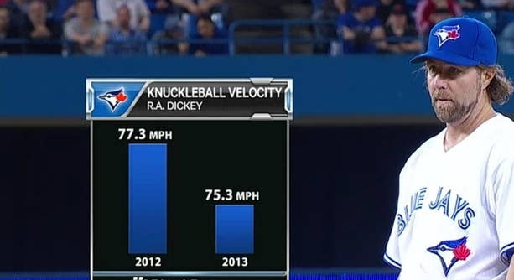
Example of a misleading visualization

Slide 7
Perception
Attention usually goes to title first
Utilize dynamic titles
Include key information and takeaways
Ex. “Differences in Friends Episode Ratings by Writer”
Keep it simple
Draw attention to important data, patterns
Adapt scale to visualization medium
Notes:
https://guides.library.jhu.edu/datavisualization/design
https://towardsdatascience.com/visual-perception-how-we-perceive-graphical-information-de5f30516009

Slide 8
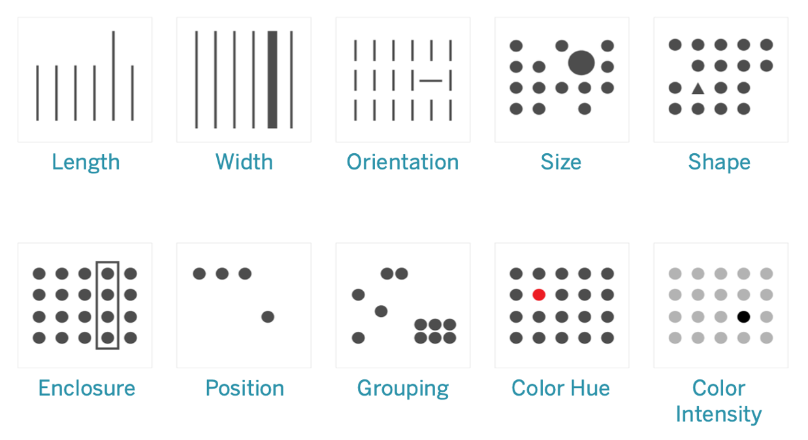
Preattentive processing
Notes:
https://help.tableau.com/current/blueprint/en-us/bp_why_visual_analytics.html

Slide 9
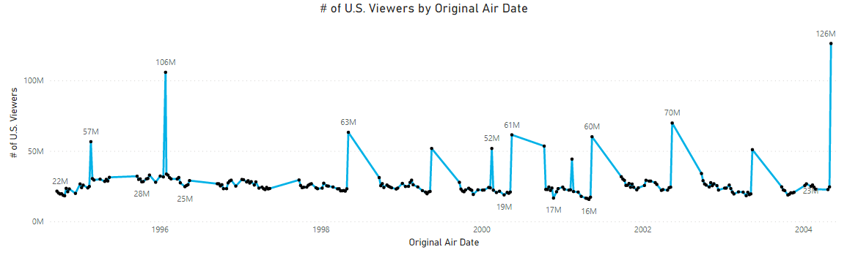
Example of drawing attention through preattentive processing

Slide 10


Color
Color can be used to convey meaning
Be careful, meaning can be cultural
Different types of color palettes based on type of data
Qualitative palette- no inherent ordering
Sequential palette- data is numeric or has natural order
Diverging palette- data is numeric and diverges from a center value
Rational palette- data has naturally related color (ex. university, country)
Notes:
https://guides.library.jhu.edu/datavisualization/design

Slide 11
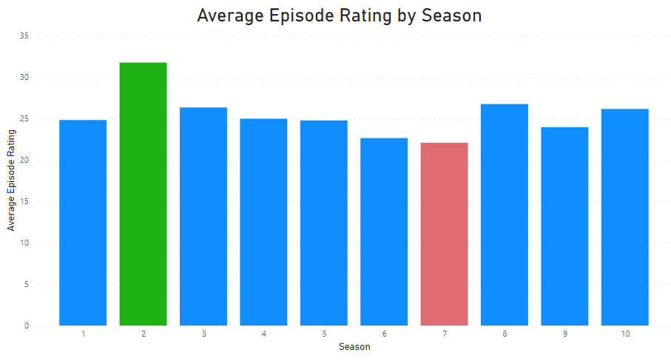
Example of meaning behind color

Slide 12
What type of visualization to use?
Type of data
Ex. Geospatial, temporal, network, 2D, 3D
Purpose of visualization
Ex. Comparison, relationship, distribution, range, flow
Viewing medium
Ex. Phone, computer, projector
Audience
Ex. Statisticians, college deans, potential future students

Slide 13
What type of visualization to use?
Data Viz Catalogue
Suggestions based on function/what is trying to be communicated
Data Viz Project
Suggestions categorized by family, data input, function, and shape
From Data to Viz
Decision trees based on type of data

Slide 14
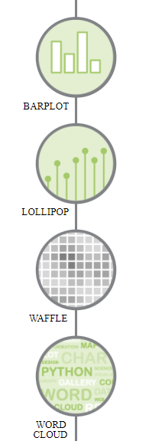
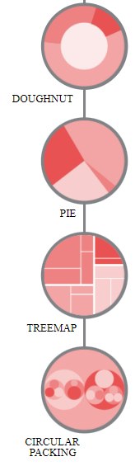
Example using From Data to Viz
Which of the Friends character had the most lines in the show?
What kind of data do you have?
Categoric
One categorical variable

Slide 15
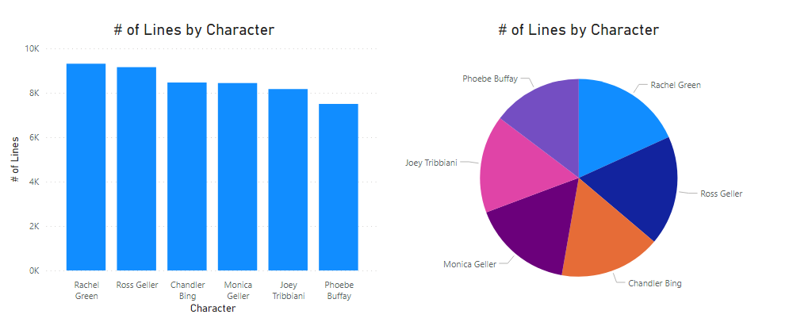
Example of choosing a visualization

Slide 16
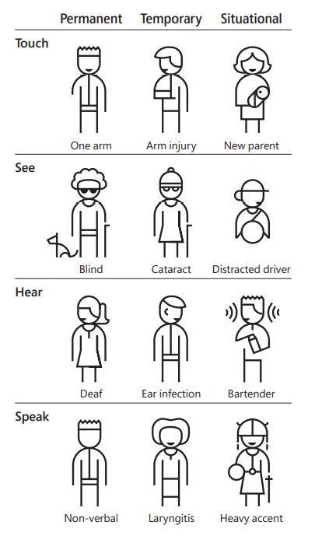
Accessibility
Web/visualization accessibility affects those with many types of disabilities, including
Auditory
Neurological
Physical
Visual
Notes:
https://www.w3.org/WAI/fundamentals/accessibility-intro/
https://www.microsoft.com/design/

Slide 17
Web Content Accessibility Guidelines (WCAG) 2.1
Created by the World Wide Web Consortium (W3C) as shared standard for web content accessibility
13 guidelines organized under 4 principles
Perceivable
Operable
Understandable
Robust
Notes:
https://www.w3.org/WAI/standards-guidelines/wcag/

Slide 18
Color
When using color, also include text or icons
Color blind friendly palettes
Pre-selected palettes or check your palette online
Coloring for Colorblindness
ColorBrewer
Check your website using Toptal Color Blind Filter or a web extension
Download Color Oracle for free to use in any program

Slide 19
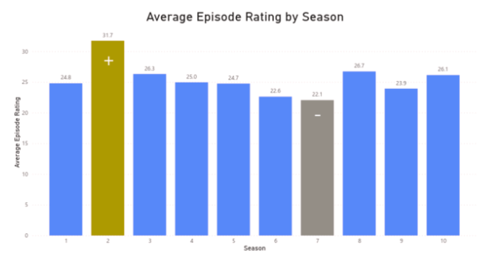
Example of protanopia (red-green) accessibility

Slide 20
Contrast
Some users with low vision cannot read text if there is not enough contrast between text and background
Others cannot read text in bright colors
Color Safe - accessible web color combinations
WCAG standard- AA is minimum level, AAA is enhanced
Sans serif or Atkinson Hyperlegible Font

Slide 21
This is low contrast
This is high contrast

Slide 22
Screen readers
Not just for blind users
Partially sighted, those with reading disorders
Descriptive, meaningful alt text
Should include type of visualization, type of data, and brief description of what visualization conveys
Can be navigated by keyboard
Free screen reader
For PC - NV Access | Download NVDA
For Apple – Apple VoiceOver
Also exist for Linux, Internet Explorer, Google Chrome
Notes:
https://it.wisc.edu/learn/accessible-content-tech/accessible-images-and-visualizations/
https://news.mit.edu/2021/data-visualizations-accessible-blind-1012

Slide 23
Example of screen reader alt text
Bar chart of average episode rating by season shows highest average at season 2 and lowest average at season 7

Slide 24
Clear, actionable takeaways
Think about the viewer’s perspective
Draw attention to important information
Be clear and succinct
Be honest

Slide 25
Why is data visualisation so important?
Visualisation is a part of each point in an analysis journey:
Exploring the data
Notes:
Data visualisation is one of the most important parts of any analysis journey. Visualisations can be used for many different purposes, such as:
Exploring the data,

Slide 26
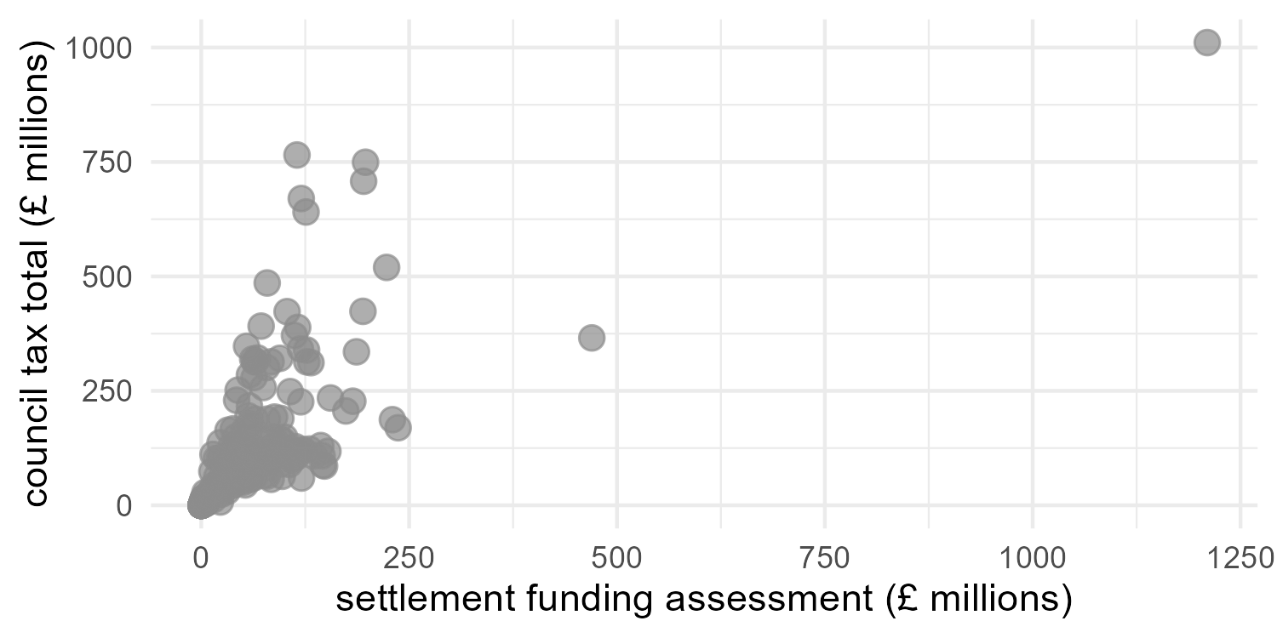
Notes:
Including identifying outliers

Slide 27
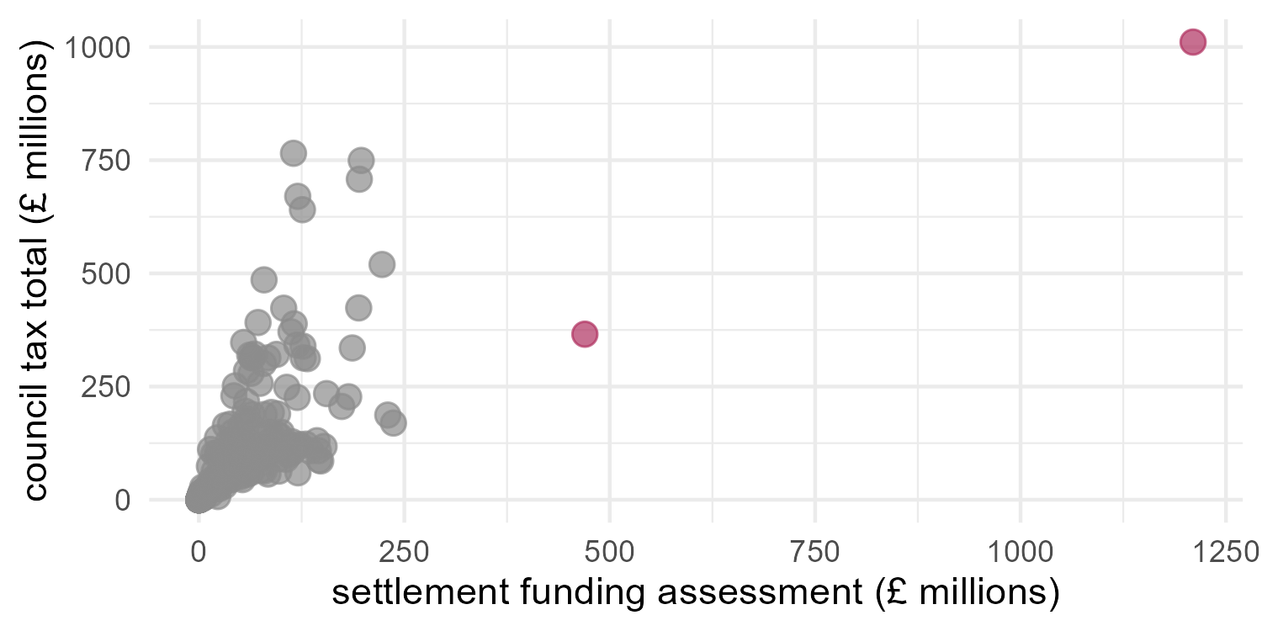
Notes:
That may be potential errors in the data

Slide 28
Why is data visualisation so important?
Visualisation is a part of each point in an analysis journey:
Exploring the data
Checking assumptions for parametric tests and models
Notes:
Checking assumptions for tests or models

Slide 29
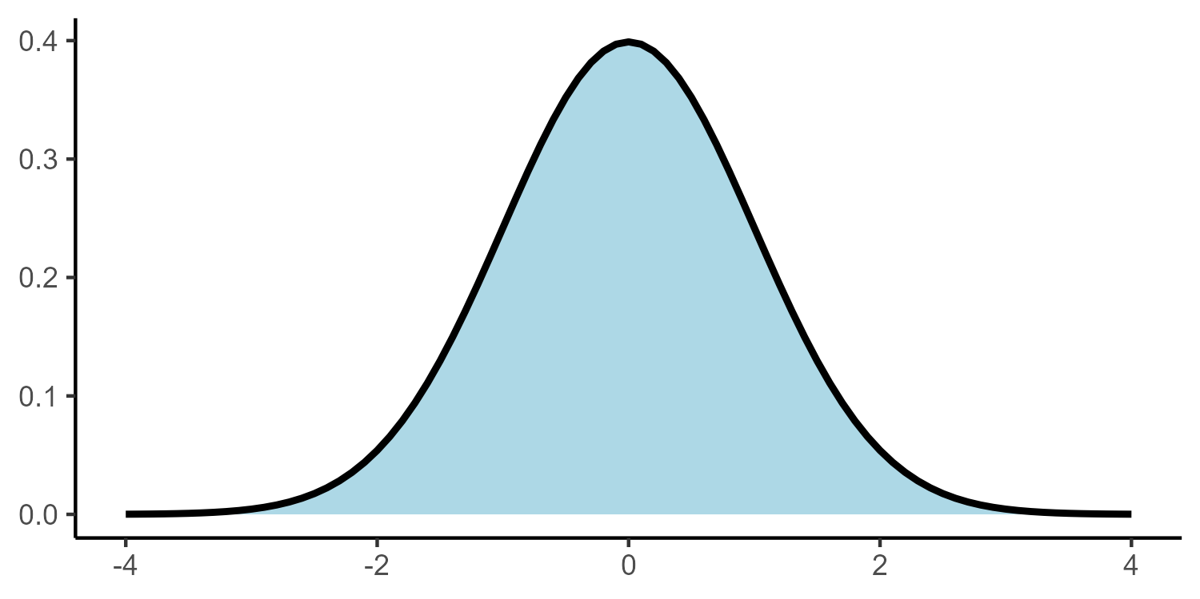
Notes:
A common assumption required for tests of numeric variables is the normal distribution

Slide 30
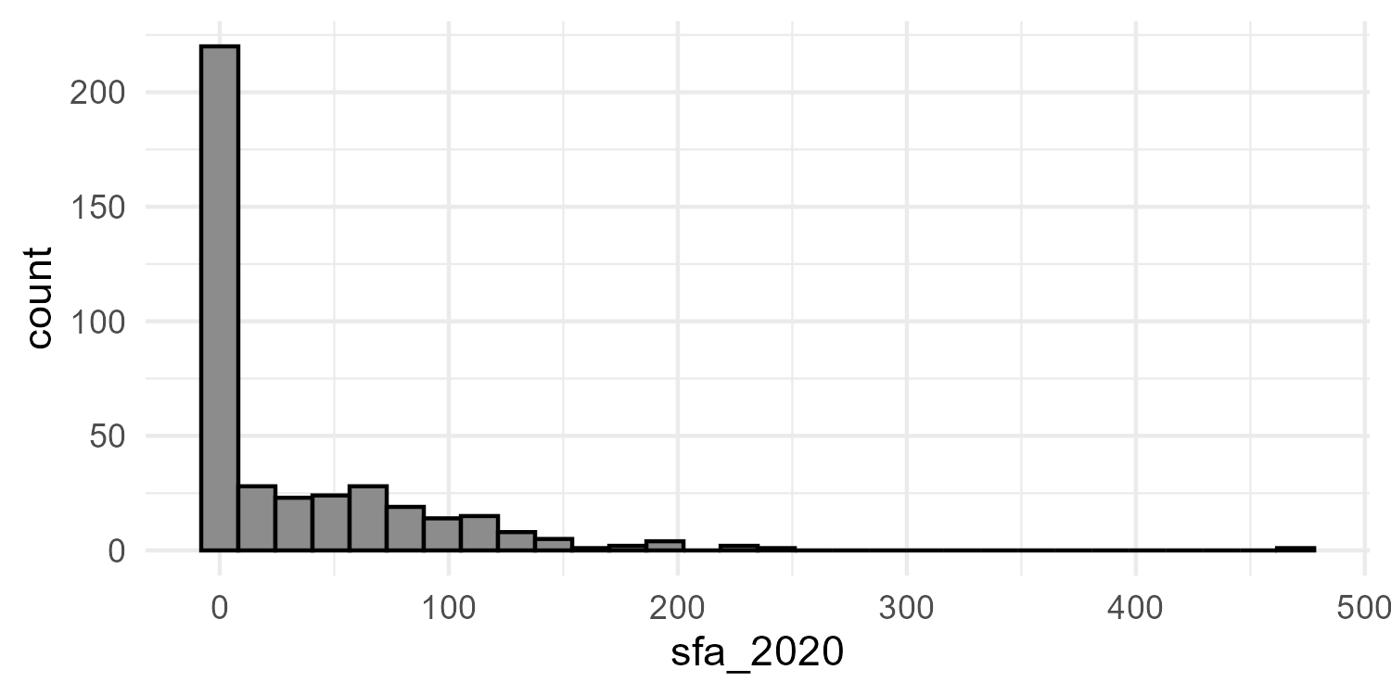
Notes:
Histograms can be used to check the shape of a variable and decide whether certain tests are valid

Slide 31
Why is data visualisation so important?
Visualisation is a part of each point in an analysis journey:
Exploring the data
Checking assumptions for parametric tests and models
Generating hypotheses about trends and relationships in the data
Notes:
Generating hypotheses about the data

Slide 32
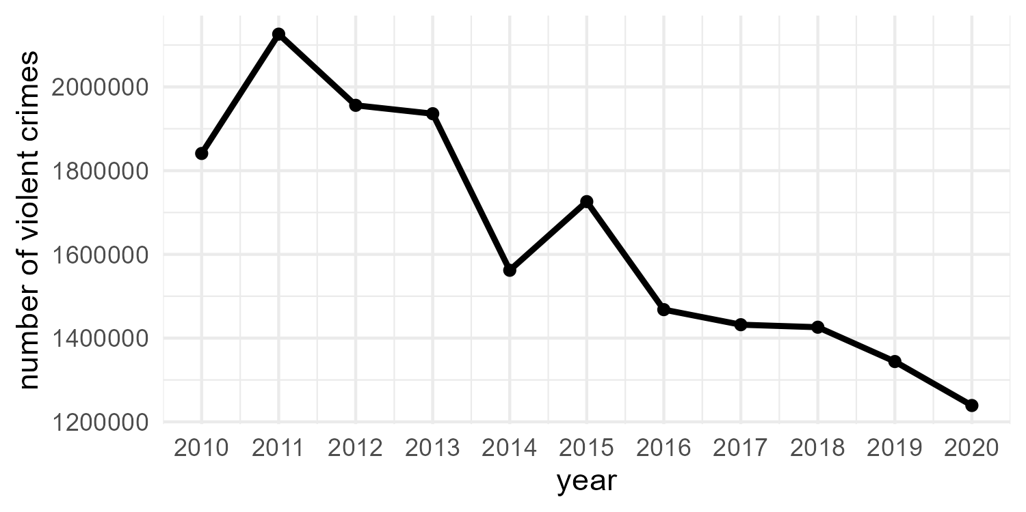
Notes:
Such as temporal trends or relationships between variables

Slide 33
Why is data visualisation so important?
Visualisation is a part of each point in an analysis journey:
Exploring the data
Checking assumptions for parametric tests and models
Generating hypotheses about trends and relationships in the data
Convey important results and messages in a clear, concise way
Notes:
And finally, they are able to convey important messages in a clear,concise way. Often in a more powerful way than simply adding text

Slide 34
What makes a ‘good’ data visualisation?
“Graphical excellence is the well-designed presentation of interesting data - a matter of substance, statistics and design” - Edward Tufte, The Visual Display of Quantitative information
How do we find the correct balance between these elements?
Notes:
Data visualisation is part art, part science. Tufte describes graphical excellence as a “matter of substance, statistics, and design”. Finding the balance of these elements can be a challenge.

Slide 35
Four key principles for good data visualisation
1. Show the data!
2. Choose an appropriate design
3. Ensure data integrity
4. Make the visualisation accessible
Notes:
To create compelling, informative data visualisations, we must adhere to four key principles:

Slide 36
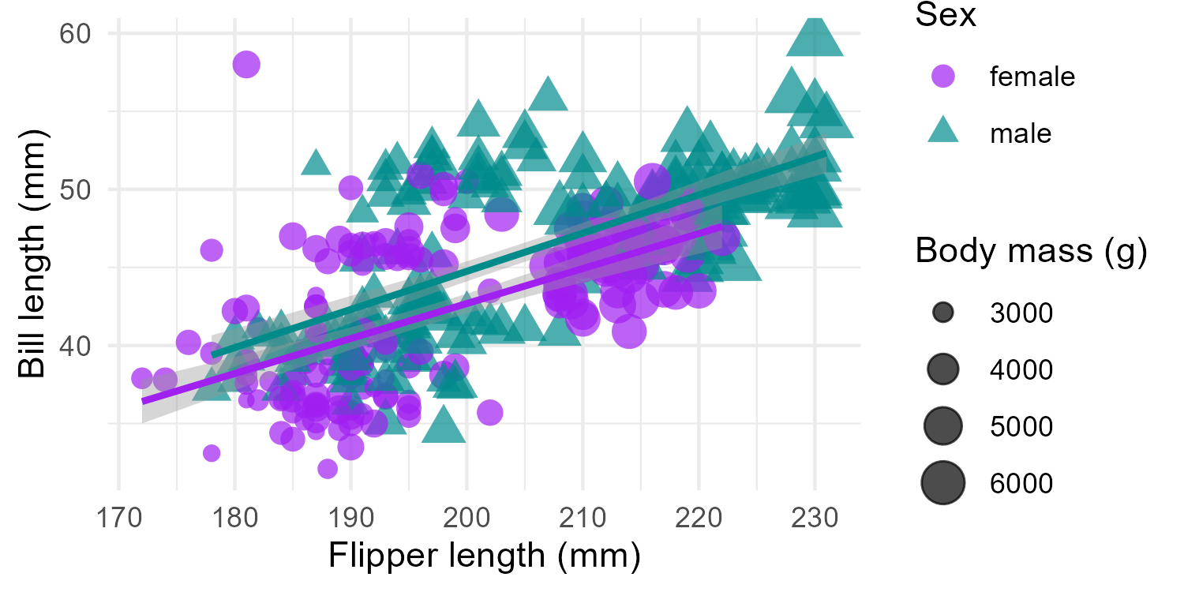
Maximise the information in the smallest amount of space
Notes:
This does not mean show all of the data. Overloading a plot can lead to confusion,

Slide 37
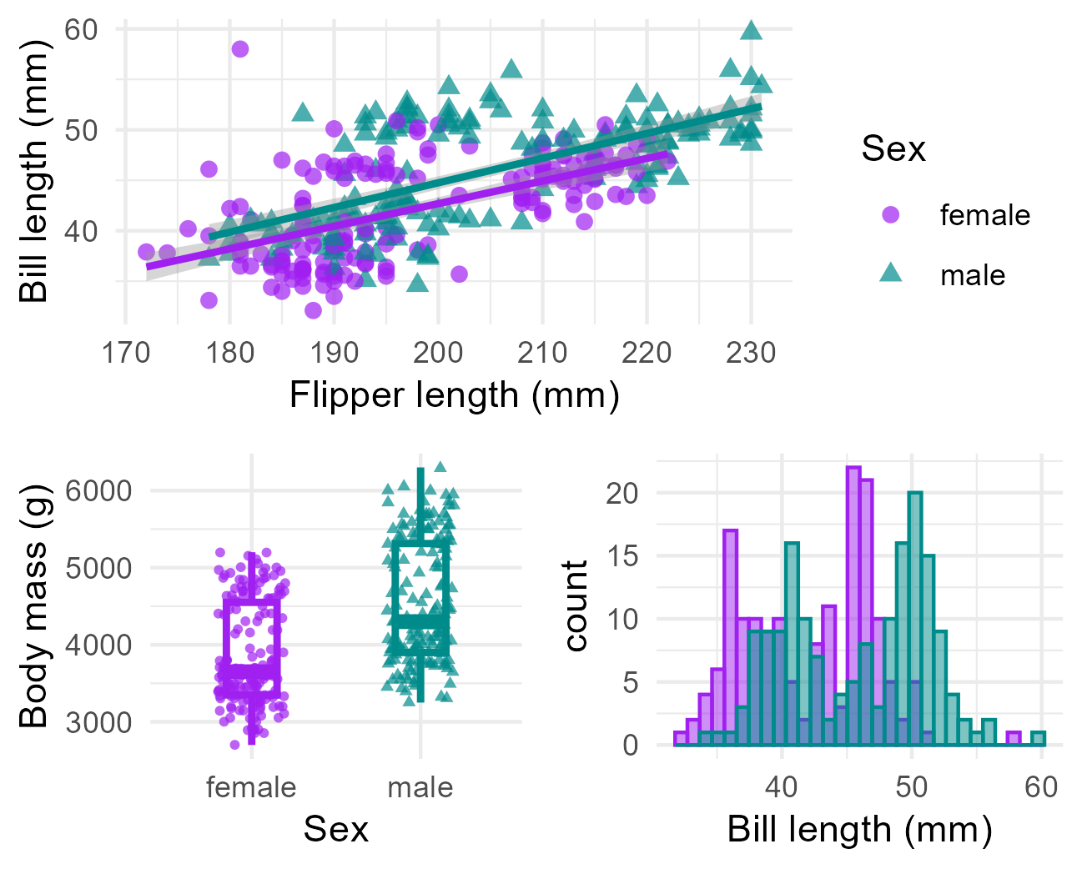
Adding too much data can lead to confusion
Notes:
Multiple, simpler graphs with a clear message is better than a single, confusing graph that hides the message we hope to impart

Slide 38


Slide 39
Visualisation design
Choice of visualisation should be decided by the context, the audience, and the goal of the graphic
Choice of visualisation will also depend on the type and number of variable we wish to show
Check out https://www.data-to-viz.com/ for visualisation choices based on variable type
Notes:
The choice of visualisation should be driven first and foremost by the context, the audience, and the goal of the graphic. This decision is also driven by the number and type of variables available. The From data to viz website4 is a great resource that gives a list of visualisations that are appropriate for each variable type and combination.

Slide 40
Visualisation design
Reduce the amount of chartjunk:
Unnecessary colours
Overbearing gridlines
Distracting patterns
BUT do not sacrifice context for minimalism
Notes:
Remove unnecessary clutter and design choices that do not enhance the intended message of the visualisation. This includes unnecessary colours and grid markings that may distract from the data.
However, do not allow the pursuit of a minimalist design detract from interpretation.

Slide 41
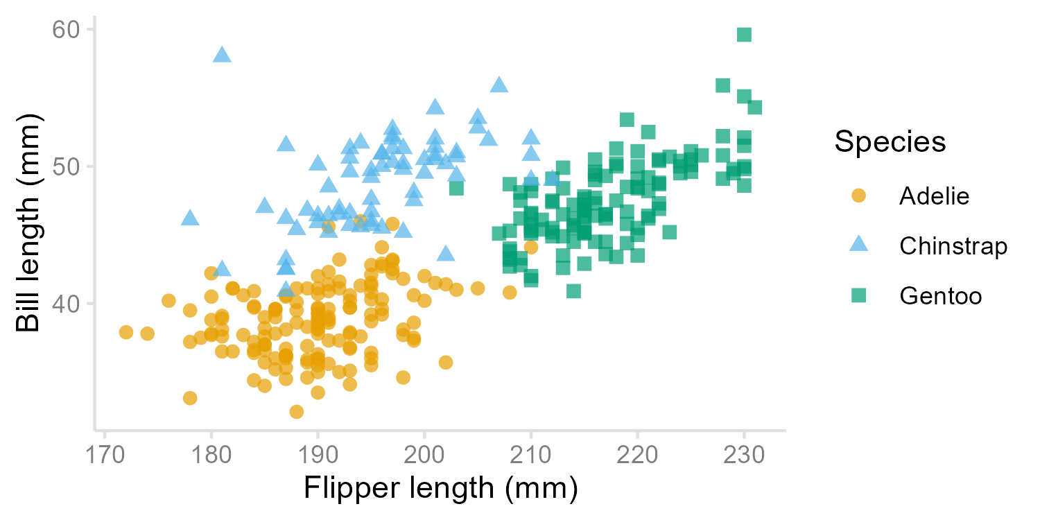
Notes:
For example, grid lines on a scatterplot can make values of points easier to read than if they are floating in space.
Good visualisation design requires a middle ground that ensures the data are the most important part of the graphic, whilst ensuring there is sufficient context.

Slide 42
Data integrity
Do not distort the data in any way!
The visual representation of data is consistent with the numerical representation
Be aware of how perceptions may alter the interpretation of a visualisation
Notes:
Data visualisations must not distort the data, nor mislead the reader.
To achieve this, we must ensure that the visual representation of data is consistent with the numerical representation.
One of the main obstacles of achieving this is that people perceive things differently, depending on their experience and the context3. We must be mindful of where these perceptions may interfere with the interpretation of a visualisation For example, research shows that people’s perception of dots, lines and bars are more accurate than distinguishing between angles, proportions, and colour hues.

Slide 43
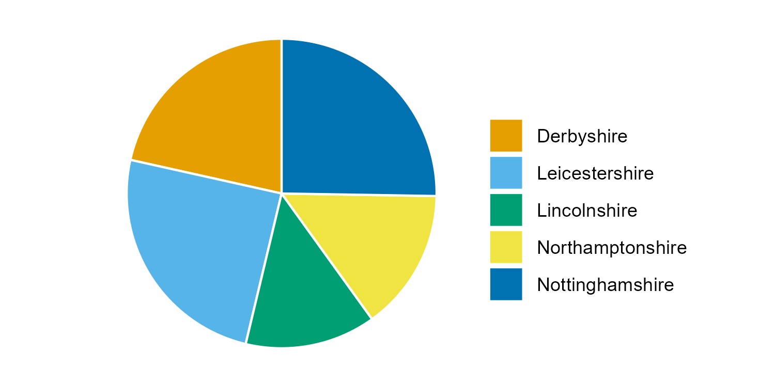
Notes:
Pie charts are an example of where differences in perception can be a challenge. The proportion of crimes recorded in Derbyshire, Leicestershire and Nottinghamshire, and the proportion recorded in Lincolnshire and Northamptonshire, are very similar. This makes it hard to identify differences between areas or make inferences about the highest (or lowest) levels of crime in the region.

Slide 44
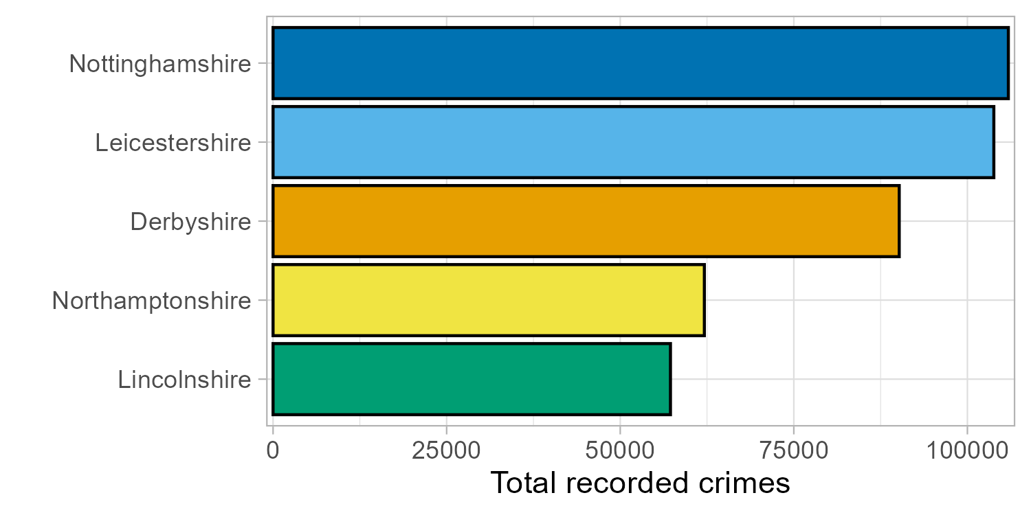
Notes:
A bar chart makes the differences between areas easier to interpret, particularly if we order the bars by length.

Slide 45
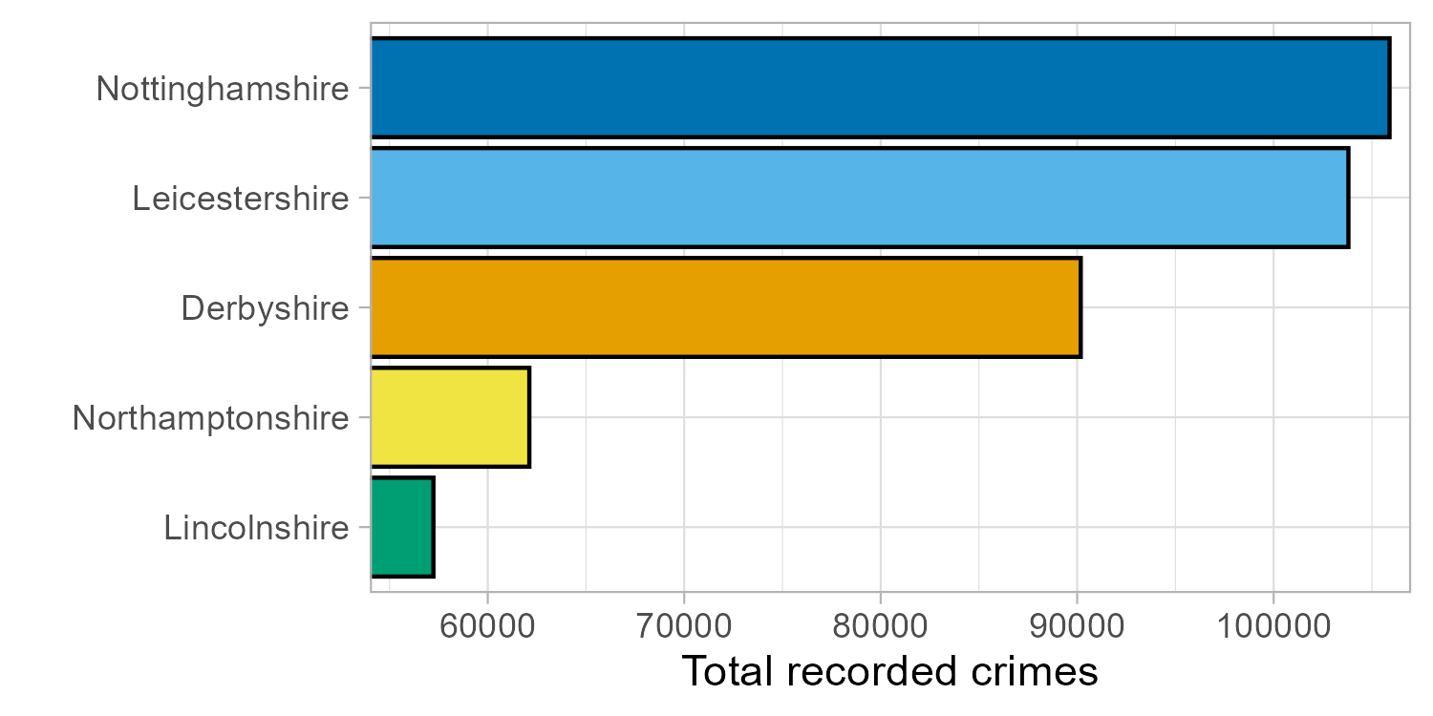
Notes:
Be careful to ensure that the amount of ink used in a visualisation is proportional to the quantities that it represents. A common violation of this is where plot axes do not begin at 0, leading to a distortion in the message. Here, this exaggerates the differences between groups, making the number of crimes in Lincolnshire and Northamptonshire look far smaller than they actually were

Slide 46
Accessibility
All aspects of a visualisation must be interpretable and accessible
Ensure design choices are inclusive
Notes:
Visualisations are useless if they are inaccessible and uninterpretable. We must ensure all design choices are inclusive. Some considerations we can make to ensure this, include

Slide 47
Accessibility: text
Make text large enough to be legible
At least 12pt when printed, 36pt for presentations
Choose an inclusive font that is accessible for visual impairment and learning difficulties
Arial and Verdana are often cited as accessible fonts
Notes:
Ensuring text is legible. This means that it is large enough to be read and using a font size that is accessible to everyone, including those with visual impairments and learning difficulties.
Guidelines suggest text should be at least size 12 when plots are printed, e.g. in reports, and 36 where they are included in a presentation. There are specialist fonts designed to aid people with visual impairments but Arial and Verdana are free fonts that are regularly cited as inclusive

Slide 48
Inclusive colours
Choose colour palettes where each colour is distinct, including to those with colour-vision deficiencies
Check palettes using a colour-blindness simulator
Notes:
Colour palettes should be chosen based on the type of data they represent. Each colour should be distinct to everyone, including those with colour-vision deficiency

Slide 49
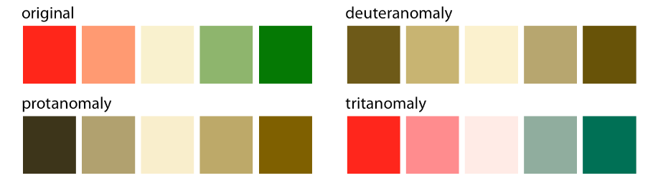
From Fundamentals of Data Visualization, Claus O. Wilke
Notes:
. A colour blindness simulator7 shows what a visualisation looks like under different types of colour blindness. Some colours are no longer distinct to people with certain colour vision deficiencies

Slide 50
Inclusive colours
Choose colour palettes where each colour is distinct, including to those with colour-vision deficiencies
Check palettes using a colour-blindness simulator
Avoid cyclical palettes like rainbow colours
Notes:
Avoid colour palettes that are cyclical, such as rainbow colours

Slide 51

Notes:
Each end merges into one another, making it difficult to distinguish between very high and very low values

Slide 52
Inclusive colours
Choose colour palettes where each colour is distinct, including to those with colour-vision deficiencies
Check palettes using a colour-blindness simulator
Avoid cyclical palettes like rainbow colours
Ensure colour choices make sense, e.g. blue for cold, red for hot and not the other way around
Avoid stereotypes such as pink for female and blue for male
Notes:
Avoid colour schemes that include stereotypes, such as pink for female, blue for male.

Slide 53
Four BI questions
1. What data is important to show?
2. What do I want to emphasize in the data?
3. What options do I have for displaying this data?
4. Which option is most effective in communicating the data?

Slide 54
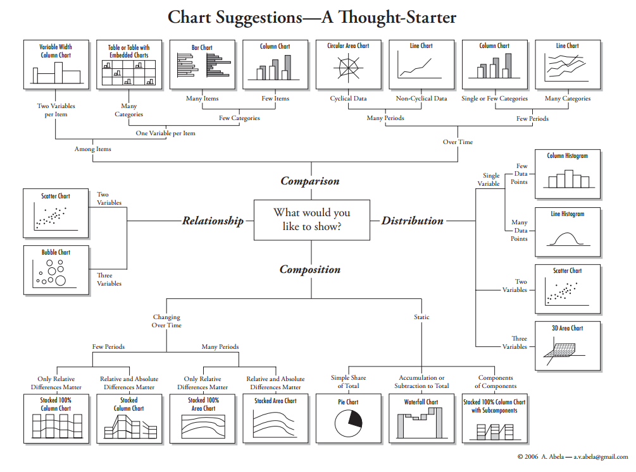

Slide 55
What do you want to show with your data?
Time Series
Ranking
Part-To-Whole
Deviation
Distribution
Correlation
Comparison

Slide 56
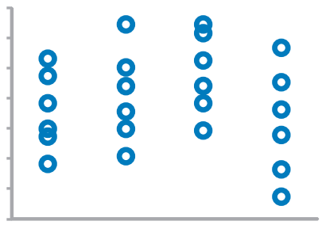
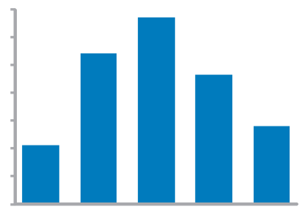
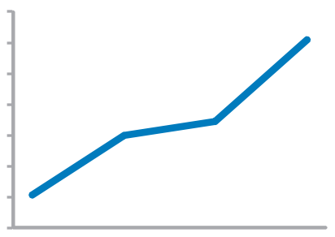
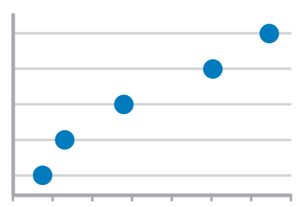
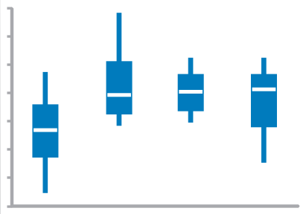
Time series values display how something changed over time
Strip Plot (multiple)
Only when also featuring distributions
Bar Graph (vertical)
To feature individual values and support their comparisons. Quantitative scale must begin at zero.
Line Graph
To feature overall trends and patterns and support their comparisons
Dot Plot (vertical)
When you do not have a value for every interval of time
Box Plot (vertical)

Slide 57
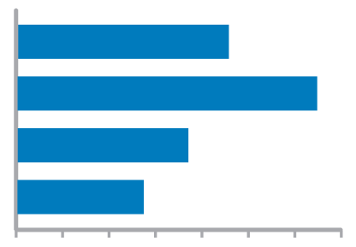
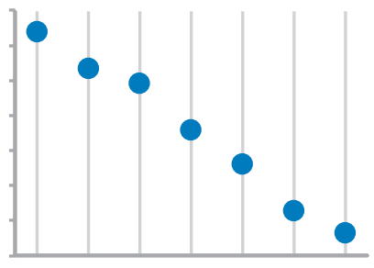
ranking values are ordered by size (descending or ascending)
Bar Graphs
Quantitative scale must begin at zero
Dot Plots

Slide 58
Part-to-whole values represent parts (ratios) of a whole
Bar Graphs
Quantitative scale must begin at zero

Slide 59
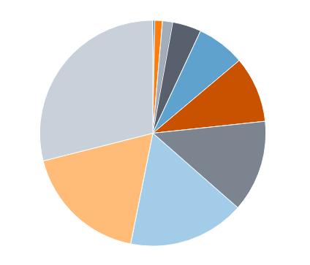
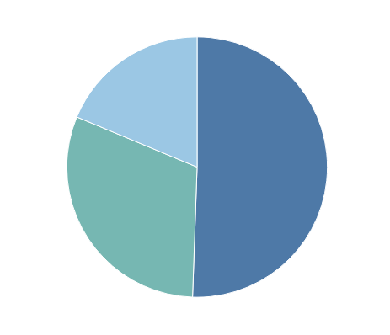
What about pie charts?
Commonly used to show parts of a whole
However…
Hard to judge relative size of pie slices – better at differentiating length
Take up a lot of space to present little information
Require labels and good color contrast to even be usable (often difficult)
Best use is when one overwhelmingly larger value than the rest – no need to focus on actual values

Slide 60
deviation difference between two sets of values
Bar Graphs
Quantitative scale must being at zero
Line Graph
Only when also featuring time series or single distribution

Slide 61

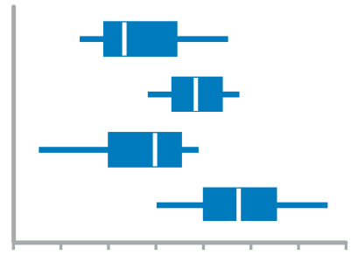
Distribution count of values per interval along quantitative scale
Strip Plot (single)
When you want to see each value
Bar Graphs
Quantitative Scale, must begin at zero
Strip Plot (multiple)
When comparing multiple distributions AND you want to see each value
Line Graph
To feature overall shape of distribution
Box Plots
When Comparing Multiple Distributions

Slide 62
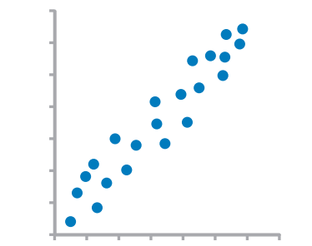
Correlation Comparison of two paired sets of values to determine if there is a relationship between them
Scatter Plot

Slide 63
Normal comparison simple comparison of values for a set of ordered items
Bar Graphs
Quantitative scale must begin at zero
Dot Plots

Slide 64
Other visualizations a picture is worth a thousand words
Schematics
Illustrations
Flow Charts
Explain how experiment was conducted or design concepts for engineering project
Raw data or statistical summaries in well-organized manner.
Convey important details.
Tables
Photographs
Great to show experimental setup, or examples of actual results

Slide 65
Adhere to data presentation standards in your field
Judged by those often familiar with research field
Expected presentations of data in that field
Review scientific articles – how is data presented?
Are there graphs?
What kind?
What statistics are used?
Review schematics – are there specific icons?
Does the journal have a style guide?

Slide 66
Visual best practices
Emphasize
most important data
Orient
graphs for legibility
Organize
graph/table
Avoid
overloading graphs
Limit
# of colors and shapes
Inform
through important text

Slide 67

Data analysis vs data visualization
Traditionally enter data into spreadsheet (Excel)
Satisfactory, but strengths are in data analysis – not visualization
Time consuming to create graph variations
Alternative: Use data visualization software
FREE to students and teachers with .edu email
https://www.tableau.com/academic/teaching

Slide 68

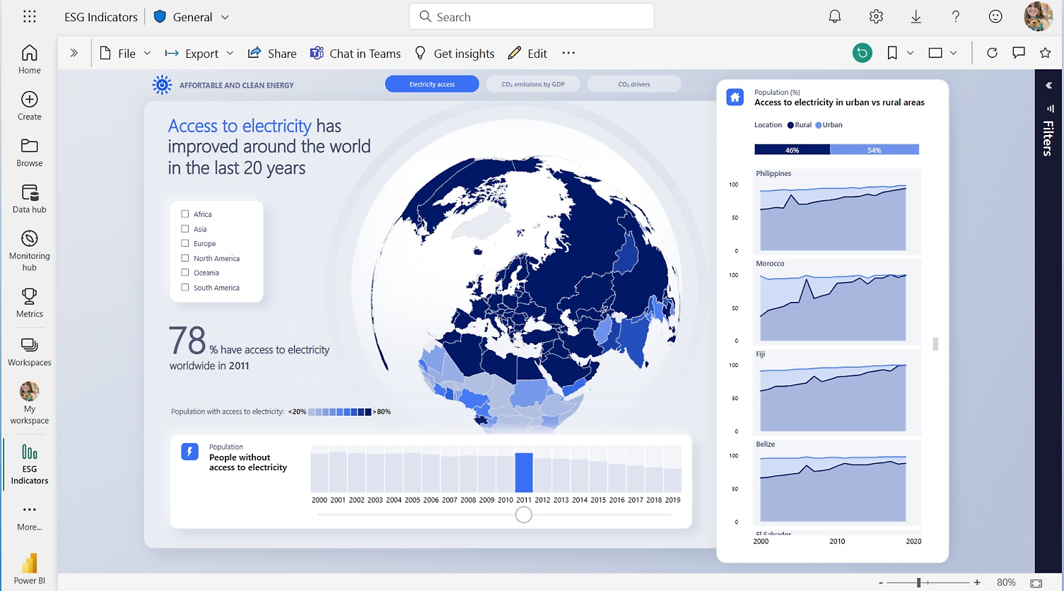
Exercise Corner!
Let’s get started with PowerBI!

Slide 69
Best practiceS & resources
Consumer Financial Protection Bureau (CFPB) Design Guidelines
Fonts, colors, components (labels, subtitles), accuracy, accessibility
WCAG guidelines
Preliminary quick checklist
Chartability
Provides accessibility-related tests for failure
Medicaid Data Visualization Best Practices
Power BI accessibility recommendations
Notes:
Data visualization guidelines - CFPB Design System
Easy Checks – A First Review of Web Accessibility | Web Accessibility Initiative (WAI) | W3C
Chartability (fizz.studio)
Tables, Graphs, Dashboard & Report Data Visualization Summary Best Practices (medicaid.gov)
Creating accessible reports in Power BI - Power BI | Microsoft Docs

